Slide 1

人工智能实践
Artificial Intelligence Practice
DCS3015 Autumn 2022
Chao Yu （余超）
School of Computer Science and Engineering
Sun Yat-Sen University

Slide 2
Lecture 8：Model-based RL
15th December 2022

Slide 3
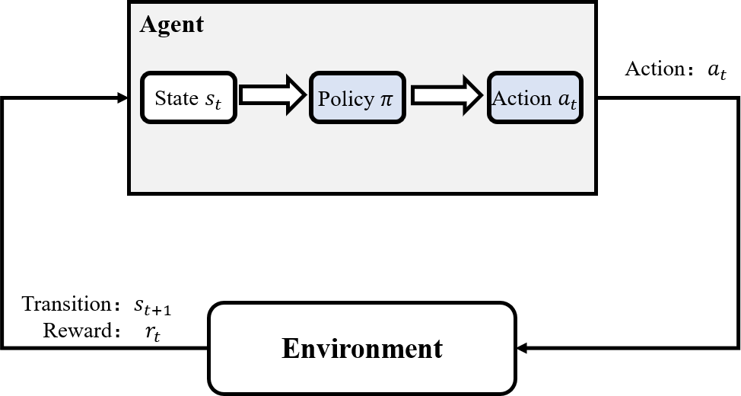
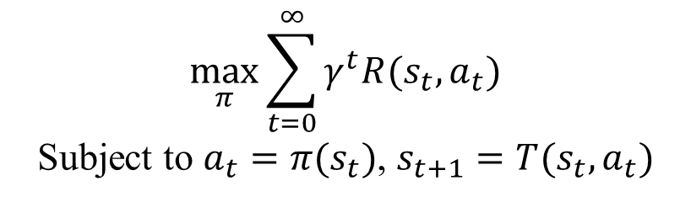
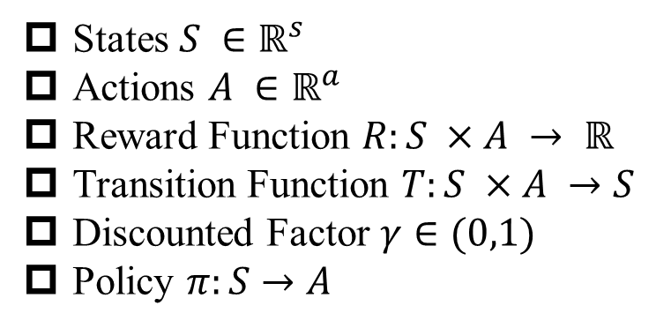
Quick Recap
States $S ∈ℝ^{s}$
Actions $A ∈ℝ^{a}$
Reward Function $R:S ×A → ℝ$
Transition Function $T:S ×A →S$
Discounted Factor $γ∈(0,1)$
Policy $π:S→A$
$$\max_{π}{\sum_{t=0}^{∞}{γ^{t}R(s_{t},a_{t})}}$$
Subject to $a_{t}=π(s_{t})$, $s_{t+1}=T(s_{t},a_{t})$

Slide 4
Quick Recap
States $S ∈ℝ^{s}$
Actions $A ∈ℝ^{a}$
Reward Function $R:S ×A → ℝ$
Transition Function $T:S ×A →S$
Discounted Factor $γ∈(0,1)$
Policy $π:S→A$
$$\max_{π}{\sum_{t=0}^{∞}{γ^{t}R(s_{t},a_{t})}}$$
Subject to $a_{t}=π(s_{t})$, $s_{t+1}=T(s_{t},a_{t})$

Slide 5
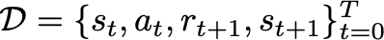
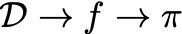
Model-free RL vs. Model-based RL
Collect data
Model-free: learn policy directly from data
e.g. Q-learning, policy gradient
Model-based: learn model, then use it to learn or improve a policy

Slide 6
Model-free RL vs. Model-based RL
Collect data
Model-free: learn policy directly from data
e.g. Q-learning, policy gradient
Model-based: learn model, then use it to learn or improve a policy
Why Model-based ?
Model-free Model-based
Asymptotic Performance
+
-
/
+
Computation
+
-
Sample Efficiency
-
+
Exploration
-
+

Slide 7


Model-free RL vs. Model-based RL
Collect data
Model-free: learn policy directly from data
e.g. Q-learning, policy gradient
Model-based: learn model, then use it to learn or improve a policy
What is a Model ?

Slide 8
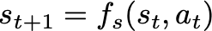
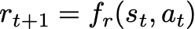
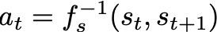
What is a Model ?
Collect data
Model-free: learn policy directly from data
e.g. Q-learning, policy gradient
Model-based: learn model, then use it to learn or improve a policy
What is a Model ?
Definition: a model is a representation that explicitly encodes knowledge about the structure of the environment and task.
state_next, reward, terminate, infos = env.step(action)
A transition/dynamics model:
A rewards model:
A inverse transition/dynamics model:

Slide 9
What is a Model ?
Collect data
Model-free: learn policy directly from data
e.g. Q-learning, policy gradient
Model-based: learn model, then use it to learn or improve a policy
What is a Model ?
Definition: a model is a representation that explicitly encodes knowledge about the structure of the environment and task.
state_next, reward, terminate, infos = env.step(action)
A transition/dynamics model:
Typically what is meant by the model in model-based RL
A rewards model:
A inverse transition/dynamics model:

Slide 10
What is a Model ?
Collect data
Model-free: learn policy directly from data
e.g. Q-learning, policy gradient
Model-based: learn model, then use it to learn or improve a policy
What is a Model ?
a₁
a₂
a₃
a₄
r₁
r₂
r₃
r₄
s₁
s₂
s₃
s₄
s₅

Slide 11
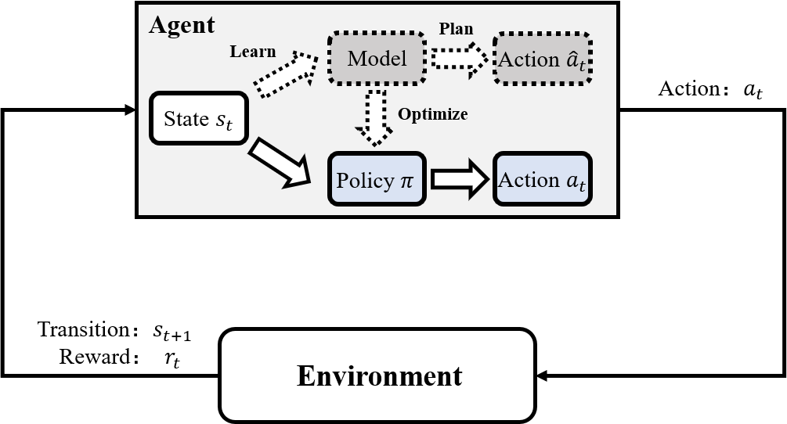
Model-based RL
Model-based RL Process:
Run base policy $π_{0}(a_{t}|s_{t})$ to collect data $𝒟=\{{\left(s_{t},a_{t},s_{t+1}\right)}_{i}\}$
For _ do
Learn transition/dynamics model $f(s,a)$
Use model $f(s,a)$ to assist agent to update policy $π(a_{t}|s_{t})$
Execute $π(a_{t}|s_{t})$ and add the resulting data $\{{\left(s_{t},a_{t},s_{t+1}\right)}_{j}\}$ to $𝒟$
End For

Slide 12
Model-based RL
Model-based RL Process:
Run base policy $π_{0}(a_{t}|s_{t})$ to collect data $𝒟=\{{\left(s_{t},a_{t},s_{t+1}\right)}_{i}\}$
For _ do
Learn transition/dynamics model $f(s,a)$
Model Building
Use model $f(s,a)$ to assist agent to update policy $π(a_{t}|s_{t})$
Model Utilizing
Execute $π(a_{t}|s_{t})$ and add the resulting data $\{{\left(s_{t},a_{t},s_{t+1}\right)}_{j}\}$ to $𝒟$
End For

Slide 13
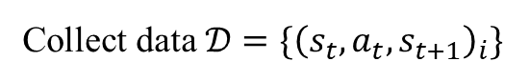
Model-based RL
Model Building
Collect data $𝒟=\{{\left(s_{t},a_{t},s_{t+1}\right)}_{i}\}$
Deterministic Model or Probabilistic Model

Slide 14
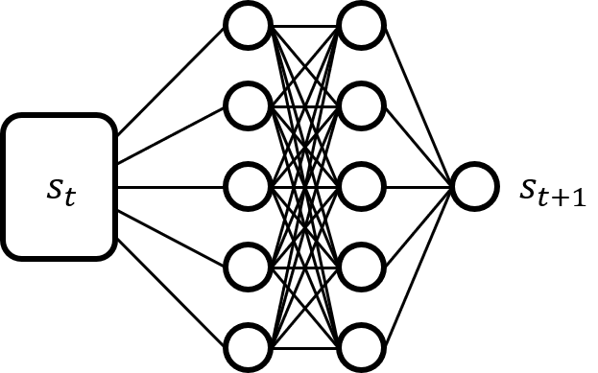
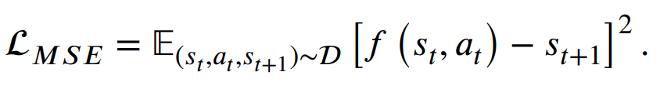
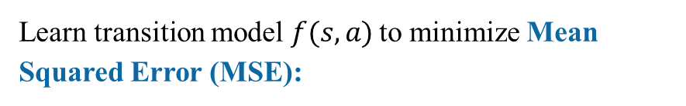
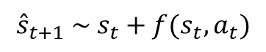
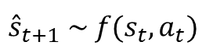
Model-based RL
Model Building
Collect data $𝒟=\{{\left(s_{t},a_{t},s_{t+1}\right)}_{i}\}$
Deterministic Model or Probabilistic Model
Learn transition model $f(s,a)$ to minimize Mean Squared Error (MSE):
$${\hat{s}}_{t+1} \sim f(s_{t},a_{t})$$
Incremental Predict:
$${\hat{s}}_{t+1} \sim s_{t}+f(s_{t},a_{t})$$

Slide 15
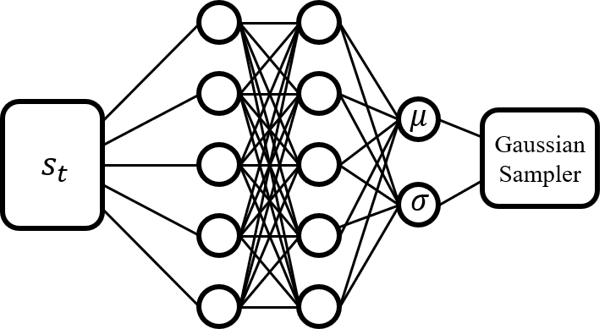
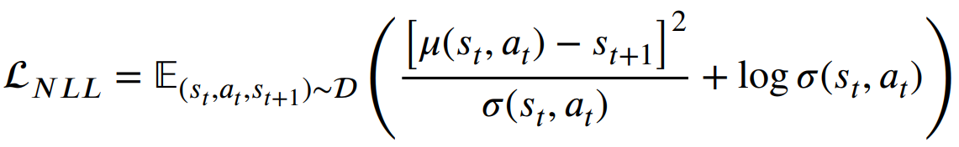
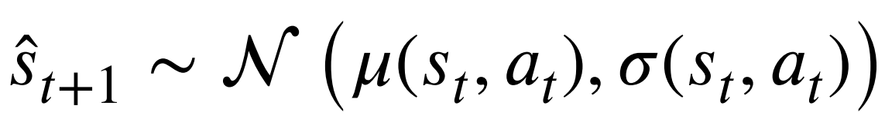
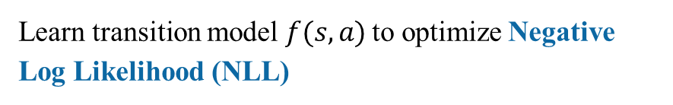
Model-based RL
Model Building
Collect data $𝒟=\{{\left(s_{t},a_{t},s_{t+1}\right)}_{i}\}$
Deterministic Model or Probabilistic Model
Learn transition model $f(s,a)$ to optimize Negative Log Likelihood (NLL)

Slide 16
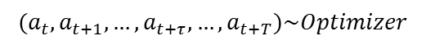
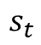
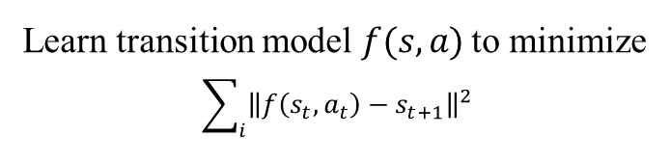
Model-based RL
Model Building:
Collect data $𝒟=\{{\left(s_{t},a_{t},s_{t+1}\right)}_{i}\}$
Learn transition model $f(s,a)$ to minimize
$$\sum_{i}{{\left\|f\left(s_{t},a_{t}\right)−s_{t+1}\right\|}^{2}}$$
Decision-Time Method (Plan):
Model Predictive Control (MPC) without Policy Function $π$
$$(a_{t},a_{t+1},…,a_{t+τ},…,a_{t+T})\sim Optimizer$$
$$s_{t}$$

Slide 17
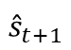
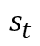
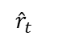
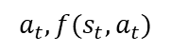
Model-based RL
Model Building:
Collect data $𝒟=\{{\left(s_{t},a_{t},s_{t+1}\right)}_{i}\}$
Learn transition model $f(s,a)$ to minimize
$$\sum_{i}{{\left\|f\left(s_{t},a_{t}\right)−s_{t+1}\right\|}^{2}}$$
Decision-Time Method (Plan):
Model Predictive Control (MPC) without Policy Function $π$
$${\hat{r}}_{t}$$
$$a_{t},f(s_{t},a_{t})$$
$${\hat{s}}_{t+1}$$
$$s_{t}$$

Slide 18
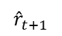
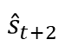
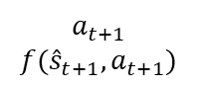
Model-based RL
Model Building:
Collect data $𝒟=\{{\left(s_{t},a_{t},s_{t+1}\right)}_{i}\}$
Learn transition model $f(s,a)$ to minimize
$$\sum_{i}{{\left\|f\left(s_{t},a_{t}\right)−s_{t+1}\right\|}^{2}}$$
Decision-Time Method (Plan):
Model Predictive Control (MPC) without Policy Function $π$
$$a_{t+1}$$
$$f({\hat{s}}_{t+1},a_{t+1})$$
$${\hat{r}}_{t+1}$$
$${\hat{s}}_{t+1}$$
$${\hat{s}}_{t+2}$$
$$s_{t}$$

Slide 19
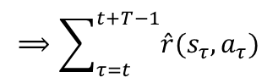
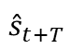
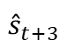
Model-based RL
Model Building:
Collect data $𝒟=\{{\left(s_{t},a_{t},s_{t+1}\right)}_{i}\}$
Learn transition model $f(s,a)$ to minimize
$$\sum_{i}{{\left\|f\left(s_{t},a_{t}\right)−s_{t+1}\right\|}^{2}}$$
Decision-Time Method (Plan):
Model Predictive Control (MPC) without Policy Function $π$
$$⟹\sum_{τ=t}^{t+T−1}{\hat{r}(s_{τ},a_{τ})}$$
……
$${\hat{s}}_{t+T}$$
$${\hat{s}}_{t+3}$$
$${\hat{s}}_{t+1}$$
$${\hat{s}}_{t+2}$$
$$s_{t}$$

Slide 20
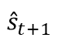
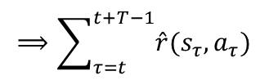
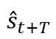
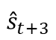
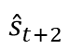
Model-based RL
Model Building:
Collect data $𝒟=\{{\left(s_{t},a_{t},s_{t+1}\right)}_{i}\}$
Learn transition model $f(s,a)$ to minimize
$$\sum_{i}{{\left\|f\left(s_{t},a_{t}\right)−s_{t+1}\right\|}^{2}}$$
Decision-Time Method (Plan):
Model Predictive Control (MPC) without Policy Function $π$
$$⟹\sum_{τ=t}^{t+T−1}{\hat{r}(s_{τ},a_{τ})}$$
……
$${\hat{s}}_{t+T}$$
$${\hat{s}}_{t+3}$$
$${\hat{s}}_{t+1}$$
$${\hat{s}}_{t+2}$$
$$⟹\sum_{τ=t}^{t+T−1}{\hat{r}(s_{τ},a_{τ})}$$
$$s_{t}$$
$${\hat{s}}_{t+T}$$
$${\hat{s}}_{t+2}$$
……
$${\hat{s}}_{t+1}$$
$${\hat{s}}_{t+3}$$

Slide 21
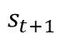
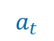
Model-based RL
Model Building:
Collect data $𝒟=\{{\left(s_{t},a_{t},s_{t+1}\right)}_{i}\}$
Learn transition model $f(s,a)$ to minimize
$$\sum_{i}{{\left\|f\left(s_{t},a_{t}\right)−s_{t+1}\right\|}^{2}}$$
Decision-Time Method (Plan):
Model Predictive Control (MPC) without Policy Function $π$
$$⟹\sum_{τ=t}^{t+T−1}{\hat{r}(s_{τ},a_{τ})}$$
……
$${\hat{s}}_{t+T}$$
$${\hat{s}}_{t+3}$$
$${\hat{s}}_{t+1}$$
$${\hat{s}}_{t+2}$$
$$⟹\sum_{τ=t}^{t+T−1}{\hat{r}(s_{τ},a_{τ})}$$
$$s_{t}$$
$${\hat{s}}_{t+T}$$
$$a_{t}$$
……
$${\hat{s}}_{t+2}$$
$$s_{t+1}$$
$${\hat{s}}_{t+3}$$

Slide 22
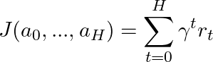
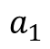
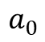
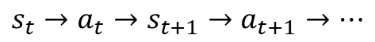
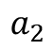
Model-based RL
Model Building:
Collect data $𝒟=\{{\left(s_{t},a_{t},s_{t+1}\right)}_{i}\}$
Learn transition model $f(s,a)$ to minimize
$$\sum_{i}{{\left\|f\left(s_{t},a_{t}\right)−s_{t+1}\right\|}^{2}}$$
Decision-Time Method (Plan):
Model Predictive Control (MPC) without Policy Function $π$
$$a_{1}$$
Trajectory Optimization with Action Sequence:
$$a_{2}$$
$$s_{t}→a_{t}→s_{t+1}→a_{t+1}→…$$
$$a_{0}$$
s₀

Slide 23
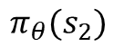
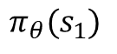
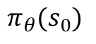
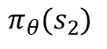
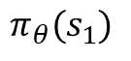
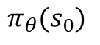
Model-based RL
Model Building:
Collect data $𝒟=\{{\left(s_{t},a_{t},s_{t+1}\right)}_{i}\}$
Learn transition model $f(s,a)$ to minimize
$$\sum_{i}{{\left\|f\left(s_{t},a_{t}\right)−s_{t+1}\right\|}^{2}}$$
Background Method (Optimize):
s₀
s₀
Mix real and model-generated experience and apply additional policy updates.
$$π_{θ}(s_{0})$$
$$π_{θ}(s_{0})$$
$$π_{θ}(s_{2})$$
$$π_{θ}(s_{2})$$
$$π_{θ}(s_{1})$$
$$π_{θ}(s_{1})$$
s₀
s₀
s₀

Slide 24





Model-based RL
Model Building:
Collect data $𝒟=\{{\left(s_{t},a_{t},s_{t+1}\right)}_{i}\}$
Learn transition model $f(s,a)$ to minimize
$$\sum_{i}{{\left\|f\left(s_{t},a_{t}\right)−s_{t+1}\right\|}^{2}}$$
Background Method (Optimize):
s₀
s₀
$$π_{θ}(s_{0})$$
Policy Optimization with parameter $θ$ :
$$π_{θ}(s_{0})$$
$$π_{θ}(s_{2})$$
$$s_{t}→π_{θ}\left(s_{t}\right)→s_{t+1}→π_{θ}\left(s_{t+1}\right)→…$$
$$π_{θ}(s_{2})$$
$$π_{θ}(s_{1})$$
$$π_{θ}(s_{1})$$
s₀
s₀
s₀

Slide 25
Model-based RL
Background vs. Decision-Time
Background Decision-Time
MBRL
Act without Learning
-
+
Unfamiliar situations
-
Decision-Time
Planning
Background
Planning
+
Computation
+
-
Predictability Coherence
+
-
Policy
Optimization
Continuous
Discreate
Discrete and Continuous
+
-
MPC
PETS
MCTS
DYNA
MBPO
MAGE

Slide 26



Decision-Time
MPC with Neural Network Model
$𝒟_{RL}=\{{\left(s_{t},a_{t},s_{t+1}\right)}_{i}\}$ to train neural network dynamic model.
Interact with Env
$𝒟_{RAND}=\{(a_{1},a_{2},…,a_{T})\}$ to store the sampled actions sequence.
(Goal) Reward Function
Planning based on Model
Agent action selection
Nagabandi, Anusha, et al. "Neural network dynamics for model-based deep reinforcement learning with model-free fine-tuning.", ICRA. 2018.

Slide 27






Decision-Time
MPC with Neural Network Model
Interact with Env
Planning based on Model
Agent action selection
Random Shooting (RS):
For $t=1$ to $T$ do:
$$random \left(a_{t}\right)∈A →𝒟_{RAND}$$
Nagabandi, Anusha, et al. "Neural network dynamics for model-based deep reinforcement learning with model-free fine-tuning.", ICRA. 2018.

Slide 28


Decision-Time
MPC with Neural Network Model
Nagabandi, Anusha, et al. "Neural network dynamics for model-based deep reinforcement learning with model-free fine-tuning.", ICRA. 2018.

Slide 29

Decision-Time
MPC with Neural Network Model
Nagabandi, Anusha, et al. "Neural network dynamics for model-based deep reinforcement learning with model-free fine-tuning.", ICRA. 2018.

Slide 30



Decision-Time
Probabilistic Ensemble with Trajectory Sampling (PETS)
Probabilistic Model Networks to capture aleatoric uncertainty.
Model Ensembles to capture epistemic uncertainty.
Model Ensemble Output:
Chua, Kurtland, et al. "Deep reinforcement learning in a handful of trials using probabilistic dynamics models." , NIPS, 2018.

Slide 31









Decision-Time
Probabilistic Ensemble with Trajectory Sampling (PETS)
Cross Entropy Method (CEM) instead of Random Shooting (RS)
……
$${\hat{s}}_{t+T}$$
$${\hat{s}}_{t+2}$$
$${\hat{s}}_{t+3}$$
$${\hat{s}}_{t+1}$$
$$s_{t}$$
$${\hat{s}}_{t+2}$$
……
$${\hat{s}}_{t+1}$$
$${\hat{s}}_{t+T}$$
$${\hat{s}}_{t+3}$$
Chua, Kurtland, et al. "Deep reinforcement learning in a handful of trials using probabilistic dynamics models." , NIPS, 2018.

Slide 32

Decision-Time
Probabilistic Ensemble with Trajectory Sampling (PETS)
Chua, Kurtland, et al. "Deep reinforcement learning in a handful of trials using probabilistic dynamics models." , NIPS, 2018.

Slide 33


Decision-Time
Probabilistic Ensemble with Trajectory Sampling (PETS)
Experiments
https://github.com/ShAw7ock/PETS-MuJoCo

Slide 34

Decision-Time
Probabilistic Ensemble with Trajectory Sampling (PETS)
Experiments
https://github.com/ShAw7ock/PETS-MuJoCo

Slide 35

Decision-Time
MuZero: Mastering Atari, Go and Chess
Monte-Carlo Tree Search (MCTS) with Dynamics Model
Schrittwieser, Julian, et al. "Mastering atari, go, chess and shogi by planning with a learned model." Nature. 2020.

Slide 36





Decision-Time
MuZero: Mastering Atari, Go and Chess
Monte-Carlo Tree Search (MCTS) with Dynamics Model
Representation Function: $s^{0}=h_{θ}\left(o_{1},…,o_{n}\right)$ to encode past observations.
Dynamic Function: $r^{k},s^{k}=g_{θ}(s^{k−1},a^{k})$
Prediction Function: $p^{k},v^{k}=f_{θ}(s^{k})$
MCTS Backup：
Schrittwieser, Julian, et al. "Mastering atari, go, chess and shogi by planning with a learned model." Nature. 2020.

Slide 37


Decision-Time
MuZero: Mastering Atari, Go and Chess
Monte-Carlo Tree Search (MCTS) with Dynamics Model
Representation Function: $s^{0}=h_{θ}\left(o_{1},…,o_{n}\right)$ to encode past observations.
Dynamic Function: $r^{k},s^{k}=g_{θ}(s^{k−1},a^{k})$
Prediction Function: $p^{k},v^{k}=f_{θ}(s^{k})$
MCTS Backup：
Schrittwieser, Julian, et al. "Mastering atari, go, chess and shogi by planning with a learned model." Nature. 2020.

Slide 38

Background
Dyna-Q
Mix real and model-generated experiences and apply for additional policy updates.
Update Q values with real transitions
Update Q values with model transitions
Sutton, Richard S. "Dyna, an integrated architecture for learning, planning, and reacting." ACM Sigart Bulletin, 1991.

Slide 39

Background
Model-Based Policy Optimization (MBPO)
Dyna-Q updates the policy with both real and model-generated transitions.
How to guarantee the policy improvement if we only use the model-generated transitions ?
Definition: Errors in the model can be exploited during policy optimization, resulting in large discrepancies between the predicted returns of the policy under the model and under the true dynamics.
$η[π]$ : the returns of the policy in true MDP; $\hat{η} [π]$ : the returns under learned model.
Janner, Michael, et al. "When to trust your model: Model-based policy optimization." NIPS, 2019.

Slide 40
Background
Model-Based Policy Optimization (MBPO)
Dyna-Q updates the policy with both real and model-generated transitions.
How to guarantee the policy improvement if we only use the model-generated transitions ?
Definition: Errors in the model can be exploited during policy optimization, resulting in large discrepancies between the predicted returns of the policy under the model and under the true dynamics.
The gap between true and model returns can be expressed in:
Generalization Error: $ε_{m}=𝔼_{s,a\sim D_{env}}\left[D_{TV}(p(s^{′}|s,a)||p_{θ}(s^{′}|s,a))\right]$
Policy Distribution: $ε_{π}=D_{TV}(π_{D} (s)||π(s))$
Janner, Michael, et al. "When to trust your model: Model-based policy optimization." NIPS, 2019.

Slide 41

Background
Model-Based Policy Optimization (MBPO)
Dyna-Q updates the policy with both real and model-generated transitions.
How to guarantee the policy improvement if we only use the model-generated transitions ?
The gap between:
Janner, Michael, et al. "When to trust your model: Model-based policy optimization." NIPS, 2019.

Slide 42

Background
Model-Based Policy Optimization (MBPO)
Dyna-Q updates the policy with both real and model-generated transitions.
How to guarantee the policy improvement if we only use the model-generated transitions ?
The gap between:
Lemma:
Janner, Michael, et al. "When to trust your model: Model-based policy optimization." NIPS, 2019.

Slide 43



Background
Model-Based Policy Optimization (MBPO)
Dyna-Q updates the policy with both real and model-generated transitions.
How to guarantee the policy improvement if we only use the model-generated transitions ?
The gap between:
Lemma:
Janner, Michael, et al. "When to trust your model: Model-based policy optimization." NIPS, 2019.

Slide 44




Background
Model-Based Policy Optimization (MBPO)
Dyna-Q updates the policy with both real and model-generated transitions.
How to guarantee the policy improvement if we only use the model-generated transitions ?
The gap between:
The returns and model returns of the policy are bounded as:
Janner, Michael, et al. "When to trust your model: Model-based policy optimization." NIPS, 2019.

Slide 45



Background
Model-Based Policy Optimization (MBPO)
Dyna-Q updates the policy with both real and model-generated transitions.
How to guarantee the policy improvement if we only use the model-generated transitions ?
H-steps Q-target objective:
Model-based Critic Loss Function:
$$Loss_{critic}=\frac{1}{2}{\left(y−Q\left(s_{t},a_{t}\right)\right)}^{2}$$
Dyna-Q one-step Q-target:
$$y=\hat{r}\left(s_{t},a_{t}\right)+γQ({\hat{s}}_{t+1},{\hat{a}}_{t+1})$$
Multi-steps Q-target:
$$y=\sum_{k=t}^{H−1}{γ^{k−t}{\hat{r}}_{k}}+ γ^{H}Q({\hat{s}}_{H},{\hat{a}}_{H})$$
Janner, Michael, et al. "When to trust your model: Model-based policy optimization." NIPS, 2019.

Slide 46

Background
Model-Based Policy Optimization (MBPO)
Dyna-Q updates the policy with both real and model-generated transitions.
How to guarantee the policy improvement if we only use the model-generated transitions ?
H-steps Q-target objective
MBPO Algorithm:
Janner, Michael, et al. "When to trust your model: Model-based policy optimization." NIPS, 2019.

Slide 47

Background
Model-Based Policy Optimization (MBPO)
Experiments
Janner, Michael, et al. "When to trust your model: Model-based policy optimization." NIPS, 2019.

Slide 48













Background
Model-based Action-Gradient Estimator (MAGE)
Typical critic network learned by temporal difference optimize for an accurate prediction of the expected return of the actor.
MAGE trains the critic network to provide action-gradients for the use in the policy improvement step.
Typical TD-Computation:
$$s′$$
$$\overline{Q}$$
$$arg\max_{a′}{Q(s^{′},a′)}$$
$$γ$$
$$×$$
$$a$$
$$+$$
$$s$$
$$R$$
$$a$$
$$−$$
$$s$$
$$Q$$
D'Oro, Pierluca et.al . "How to Learn a Useful Critic? Model-based Action-Gradient-Estimator Policy Optimization." NIPS, 2020.
Notes:
1. the value provided by the critic is neither used for improving the policy nor for acting in the environment

Slide 49







Background
Model-based Action-Gradient Estimator (MAGE)
Typical critic network learned by temporal difference optimize for an accurate prediction of the expected return of the actor.
MAGE trains the critic network to provide action-gradients for the use in the policy improvement step.
MAGE TD-Computation:
$$a$$
$$\hat{s}$$
$$s$$
$$\hat{p}$$
$$\overline{Q}$$
$$\hat{s}$$
$$π$$
$$a′$$
$$γ$$
$$×$$
$$a$$
$$+$$
$$s$$
$$R$$
$$a$$
$$−$$
$$s$$
$$Q$$
D'Oro, Pierluca et.al . "How to Learn a Useful Critic? Model-based Action-Gradient-Estimator Policy Optimization." NIPS, 2020.

Slide 50
Background
Model-based Action-Gradient Estimator (MAGE)
Typical critic network learned by temporal difference optimize for an accurate prediction of the expected return of the actor.
MAGE trains the critic network to provide action-gradients for the use in the policy improvement step.
MAGE TD-Computation:
$$a$$
$$\hat{s}$$
$$s$$
$$\hat{p}$$
$$\overline{Q}$$
$$\hat{s}$$
$$π$$
$$a′$$
$$γ$$
$$×$$
$$a$$
$$+$$
$$s$$
$$R$$
$$a$$
$$−$$
$$s$$
$$Q$$
D'Oro, Pierluca et.al . "How to Learn a Useful Critic? Model-based Action-Gradient-Estimator Policy Optimization." NIPS, 2020.

Slide 51

Background
Model-based Action-Gradient Estimator (MAGE)
Typical critic network learned by temporal difference optimize for an accurate prediction of the expected return of the actor.
MAGE trains the critic network to provide action-gradients for the use in the policy improvement step.
MAGE Algorithm:
D'Oro, Pierluca et.al . "How to Learn a Useful Critic? Model-based Action-Gradient-Estimator Policy Optimization." NIPS, 2020.

Slide 52
Model-based RL with Images
Dreamer: Latent Imagination
Latent state-transition models
a₁
a₂
a₃
a₄
r₂
r₃
r₄
r₅
Reconstruct high-level observation to low-level latent state
z₁
z₂
z₃
z₄
z₅
o₁
o₄
Hafner, Danijar, et al. "Dream to control: Learning behaviors by latent imagination." arXiv preprint arXiv:1912.01603 (2019).

Slide 53

Model-based RL with Images
Dreamer: Latent Imagination
Latent state-transition models
Hafner, Danijar, et al. "Dream to control: Learning behaviors by latent imagination." arXiv preprint arXiv:1912.01603 (2019).

Slide 54



Inverse Model
Intrinsic Curiosity Module (ICM)
Besides extrinsic reward, agent set intrinsic reward to express its familiarity with the true environment. (Curiosity Driven)
Model Prediction: $f(s_{t},a_{t})→s_{t+1}$
Intrinsic Reward: $r_{t}^{in}\sim {\left\|f\left(s_{t},a_{t}\right)−s_{t+1}\right\|}_{2}^{2}$
Forward Dynamics Model：
$$f_{ψF}({ϕ (s}_{t}),a_{t})→{\hat{φ} (s}_{t+1})$$
Inverse Model：
$g_{ψI}({φ(s}_{t}),{ϕ(s}_{t+1}))→{\hat{a}}_{t}$.
Intrinsic Reward：
$$r_{t}^{i}={\left\|{\hat{φ} (s}_{t+1})−{ϕ(s}_{t+1}))\right\|}_{2}^{2}$$
Pathak, Deepak, et al. "Curiosity-driven exploration by self-supervised prediction." International conference on machine learning. ICML, 2017.
Notes:
状态特征提取函数：
$φ(s_{t})$ 特征提取CNN的学习过程就是利用逆动力学模型的监督学习的过程。如果需要预测action，CNN需要捕获与agent动作相关的变化，而忽略其他的因素

Slide 55
Deep Reinforcement Learning
谢 谢！
中山大学计算机学院

